Slide 1







Personal
Software Process
Software development life cycle stages.

Slide 2





Contents
01
02
03
Introduction
Objectives of PSP
PSP Phases
04
05
06
PSP Metrics
Benefits of PSP
Challenges and Solution

Slide 3

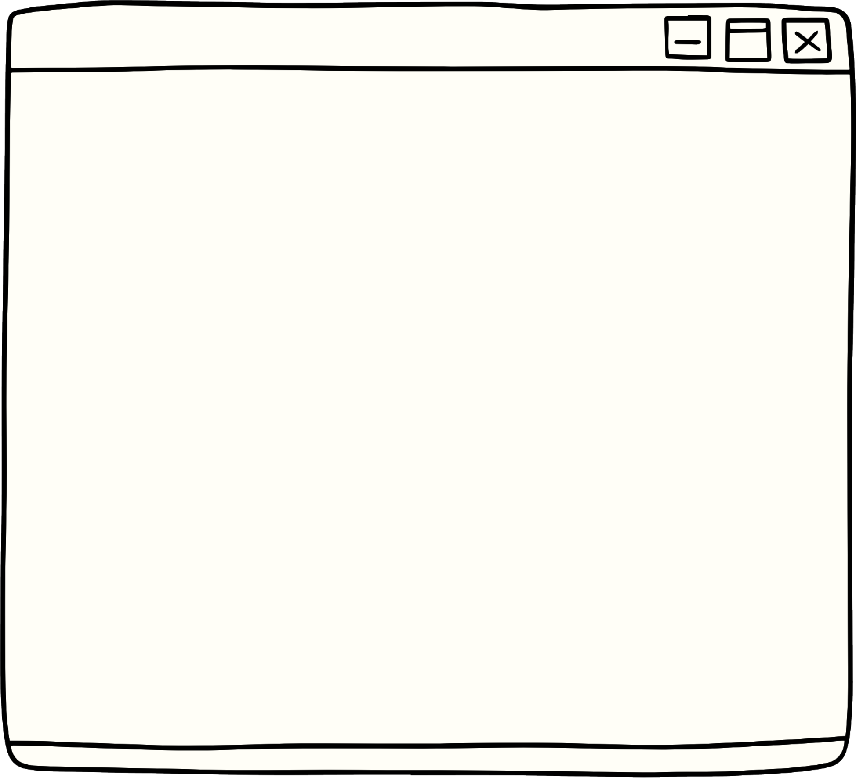


Introduction
Defination: Personal Software Process (PSP) is a structured framework for software developers to improve individual coding and project management skills.
Purpose: The primary goal is to enhance code quality, reduce defects, and bring predictability to project timelines through disciplined personal processes.
Importance: In an industry where quality and efficiency are paramount, adopting PSP can significantly contribute to personal and team success in software development.

Slide 4

Improving indivisual Devloper’s skills
Enhancing code quality
Objectives
Emphasizes personal skill development in coding, design, testing, and project management.
Aims to empower developers with a structured approach to enhance their expertise.
Focuses on producing high-quality, error-free code through rigorous personal processes.
Encourages adherence to coding standards and best practices.
Improving indivisual Devloper’s skills
Enhancing code quality.
Reducing defects and error.
Ensuring better predictabilty in project timelines
Ensuring Better Predictability in Project Timelines
Enhancing code quality
Aims to minimize defects by implementing comprehensive testing practices at the individual developer level.
Promotes proactive defect identification and correction.
Provides a disciplined approach to project planning, estimating, and tracking.
Strives to bring predictability and reliability to project schedules.

Slide 5







Planning
Design
Definition: Involves defining project goals and Find resources and time.
Objectives: Set clear objectives, identify potential risks, and establish a roadmap for the development process.
Definition: Creating detailed design specifications based on project requirements.
Objectives: Develop a blueprint for coding, Challenges and plan for efficient implementation.
Test
Definition: Executing various test cases to identify and fix defects.
Objectives: Test the code to minimize defects, verify functionality, and ensure the software meets specified requirements.
PSP Phases
Code
Compile
Definition: Writing code based on the established design specifications.
Objectives: Implement coding standards, ensure clarity and efficiency in code, and adhere to best practices.
Definition: Building and compiling the code to check for syntax errors.
Objectives: Ensure the code is error-free at a basic level and ready for further testing.

Slide 6
PSP Metrics
Defect Density:
Definition: The number of defects identified per unit of code.
Objective: Measure the quality of code by identifying and minimizing the occurrence of defects. A lower defect density indicates higher code quality.
Time Estimation Accuracy:
Definition: The accuracy of time estimates made during planning compared to actual time taken.
Objective: Improve project planning by assessing the accuracy of time estimates, helping to create more realistic schedules and deadlines.

Slide 7
PSP Metrics
Productivity Metrics:
Definition: Measures such as lines of code written per hour or function points completed.
Objective: Assess and enhance individual productivity by tracking the efficiency of coding and development activities.
Code Size and Complexity Metrics:
Definition: Analyzing the size and complexity of the codebase.
Objective: Understand and manage code complexity to ensure maintainability and reduce the risk of errors.

Slide 8
PSP Metrics
Time Distribution Across Phases:
Definition: Analyzing the time spent on each phase of the development process.
Objective: Optimize time distribution to identify bottlenecks, streamline processes, and improve overall efficiency.

Slide 9





Challenges
Challenge
Challenge
Challenge
Resistance to Change:
Description: Developers may resist adopting new processes initially, fearing disruptions to their established workflow.
Time and Resource Constraints:
Description: Limited time and resources may hinder the implementation of the full PSP framework.
Initial Learning Curve:
Description: Learning and implementing PSP practices may require an initial investment in training and adaptation.

Slide 10
Solutions
Solution
Solution
Solution
Description: Implement strategies to communicate the benefits of PSP, involve team members in decision-making, and gradually introduce changes.
Description: Start with small, manageable steps, gradually incorporating PSP practices to minimize disruption to ongoing projects.
Description: Provide training sessions, resources, and mentorship to help developers overcome the initial learning curve and build confidence in PSP practices.

Slide 11


Thank you

